Slide 1
Robust Multi-Source Sales Data Pipeline
Built by Poojitha Gollapudi for Flipkart Task-1

Slide 2
Project Overview
Custom sales data pipeline: ingests, cleans, analyzes, visualizes
Supports CSV, JSON, Excel
Modular, visualization-capable, insight-rich, extensible

Slide 3
File Structure
Data_Pipe_Updated.py – Main script
Product_metadata.json – Dataset
region_info.xlsx – Dataset
Sales_data.csv – Dataset
Sales_database.db – Database (SQLite)

Slide 4
Key Features
Multi-source data loading
Data-cleaning & type conversion
Smart merging
Insight extraction & visualizations
Exports & custom handling
Database Management using SQLite

Slide 5
Requirements
pip install pandas numpy matplotlib seaborn tabulate openpyxl sqlite3
Download these extensions in your command prompt or Terminal

Slide 6
How to Use
Import the required data files in the Jupyter Notebook/ VS code
Install SQLite in the system for database management and connect with the python using sqlite3 library
Run: Data_Pipe_Updated.py file in the VS Code/ Jupyter Notebook
Prompt to generate insights & visualizations

Slide 7
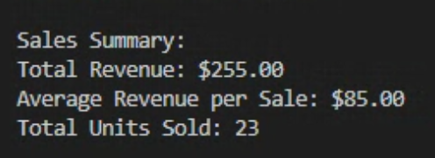
Example Insights
Total Revenue : $ 255.00
Average Revenue per Sale : $ 85.00
Total Units Sold : 23

Slide 8
Sample Visuals
Monthly Sales Trend Plot Chart
Top Products By units Bar Chart
Revenue by Product Category Column Chart
Revenue Distribution by Region Pie Chart

Slide 9
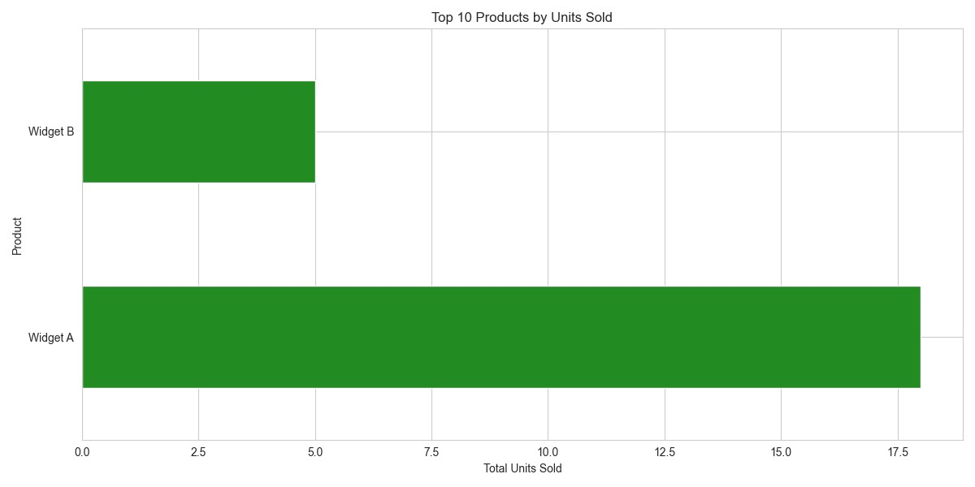
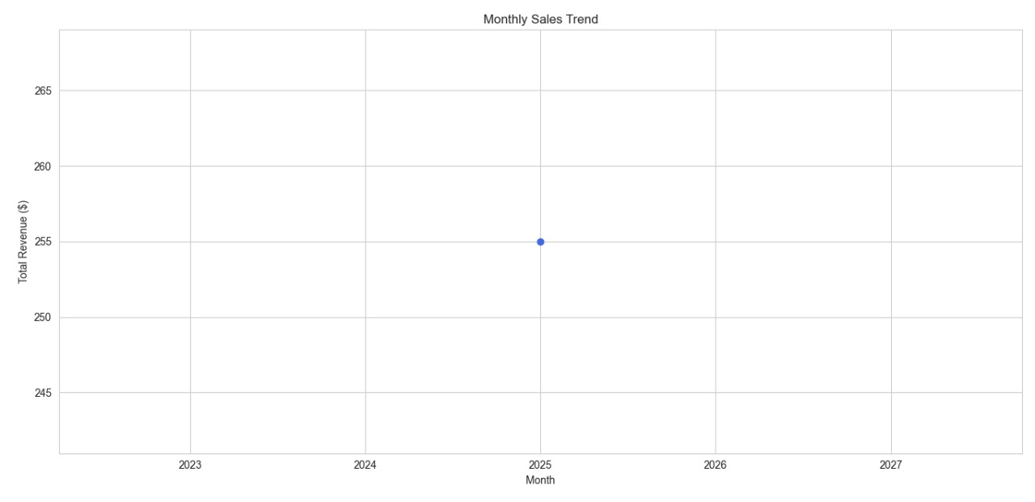
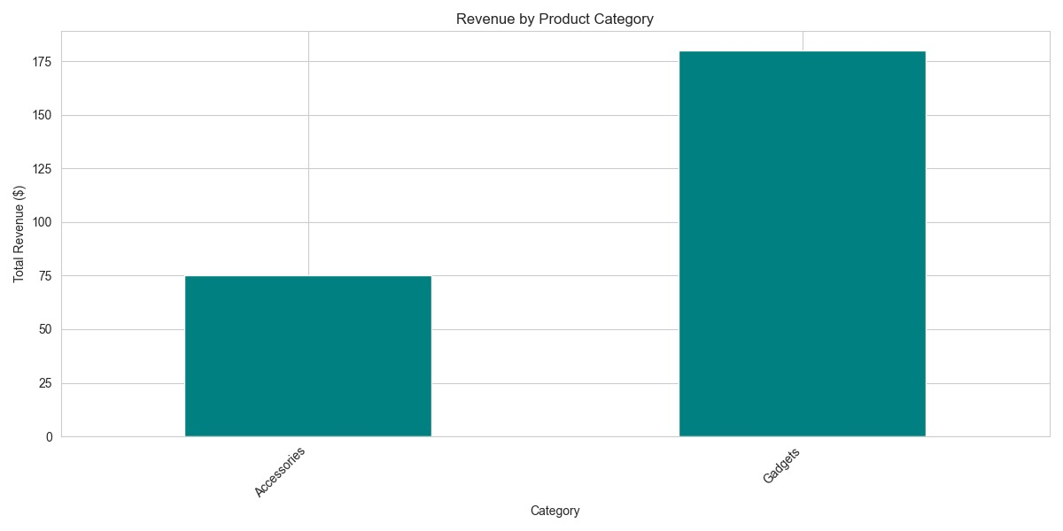
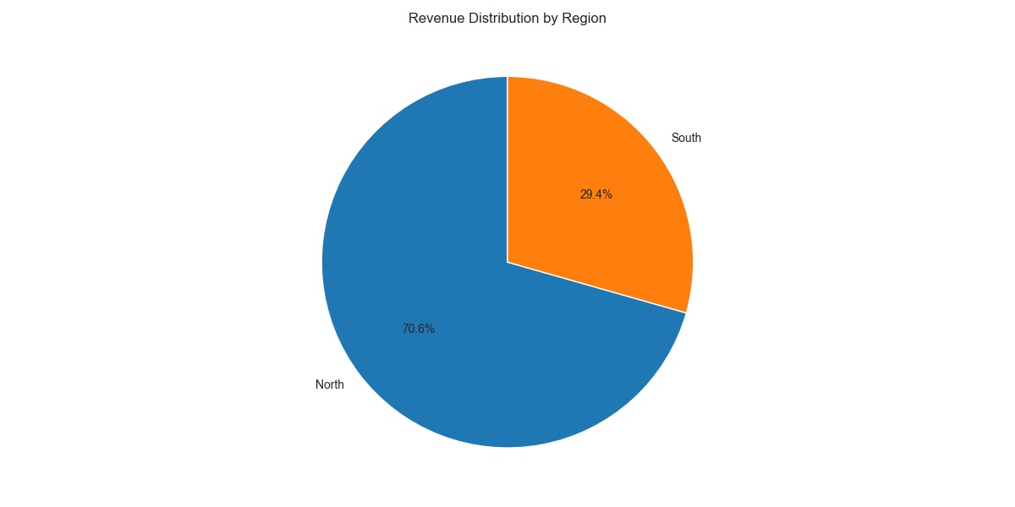

Slide 10
Error Handling
Handles missing or corrupt files gracefully
Warns about unsupported formats or merge conflicts import related libraries to overcome.
Eg. Openpyxl library is installed and imported to run excel files

Slide 11
Version Control
Git for tracking changes
Code is production-ready and AI-clean

Slide 12
Author
Poojitha Gollapudi
Flipkart Data Pipeline Task-1 Project

